Slide 1
Cluster Computing Overview
Module 9

Slide 2
Module Objectives
After this module, participants will be able to:
Explain concepts of Cluster Computing.
Explain various architectures of Cluster Computing.
Notes:
Instructor Notes:
Please review the course objectives with students. Also, ask them why they are taking this course and what are they hoping to achieve.
Participant Notes:

Slide 3
Cluster Computing Overview
Notes:
Instructor Notes:
This section will look at how Cluster Computing has evolved
Participant Notes:

Slide 4
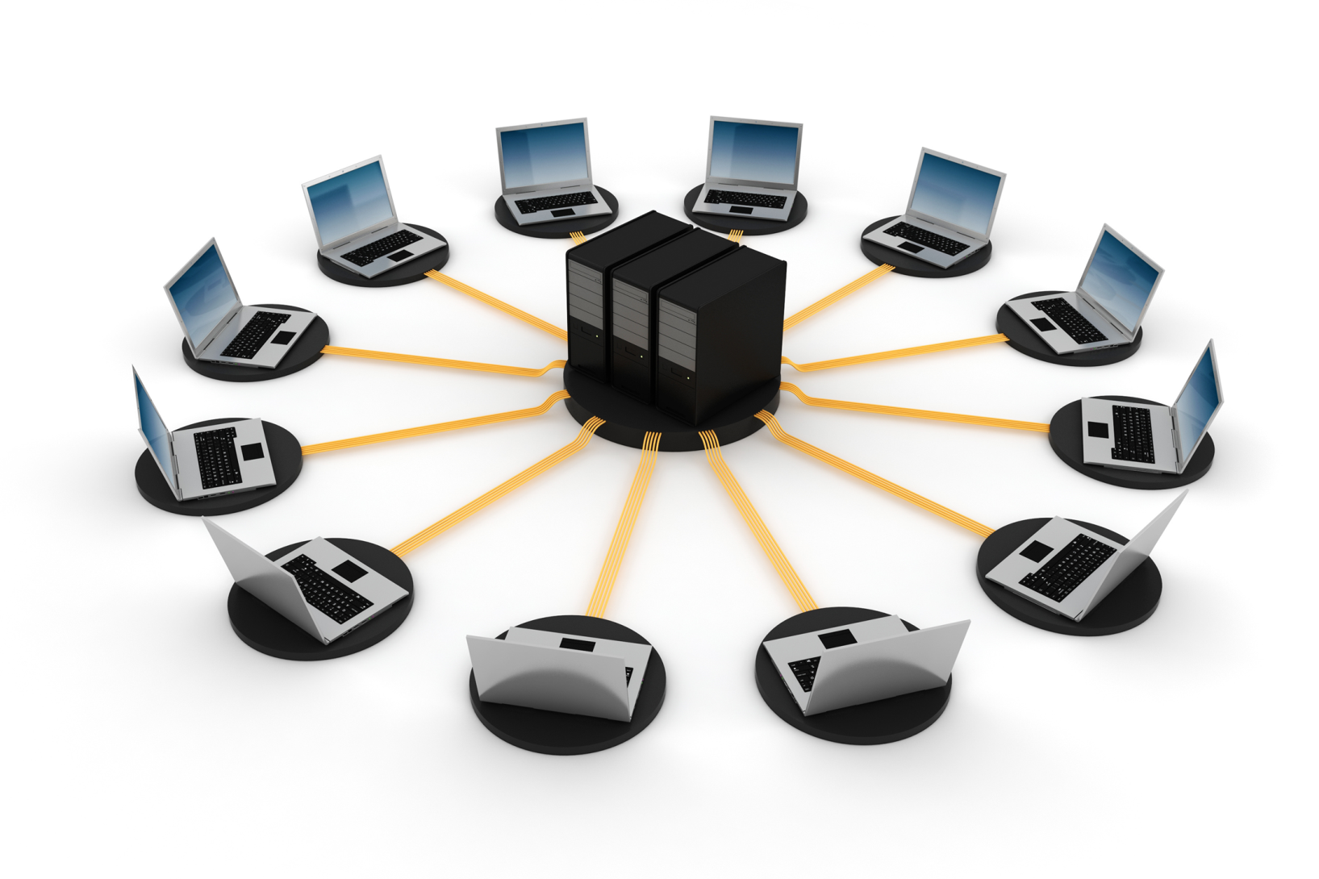
"Compute Cluster" - Definition
"Many interconnected computers working together as a single system"
Notes:
Instructor Notes:
Ask students if they can think of any other definitions of cluster computing.
Participant Notes:

Slide 5

The Need for Cluster Computing
Big Data
Dealing with large amounts of data requires more than one computer. E.g., Airbnb: Petabyte data lake
Big Users
Applications can have a large number of users. E.g., Netflix has 100M+ subscribers
'Always On' Services
Users expect services to always be available with zero downtime.
Specialized dedicated high-performance computers tend to be very expensive.
Notes:
Instructor Notes:
Ask users to guess if they have worked with any cluster service.
Participant Notes:
Two technologies really propelled the need and use for Cluster Computing:
Web
Mobile
These technologies now allows millions of users to use a service.
So the service needs to be run on a cluster of machines for scale.

Slide 6

Benefits of Cluster Computing
Performance
Scale
Always On Services
Computing tasks much faster on many machines than on a single machine.
Can scale resources to match increasing data and compute needs.
Services running as a cluster can provide zero downtime service.
Notes:
Instructor Notes:
Instructor Notes are the same as Participant Notes.
Please present the Participant Notes.
Participant Notes:
Some applications are designed to work as a cluster.
Examples include: Hadoop, Spark and Cassandra.
These systems understand they are running on a cluster, and can self-heal if machines go down.
It’s also possible to run applications that are 'not cluster aware' as a cluster.
For example, a web service can be run on multiple machines.
Each instance of the web service is unaware of the other services running.

Slide 7

Cluster Computing Evolution
Lots of proprietary cluster systems (VAXCluster from DEC, etc.)
Google builds a massive cluster for indexing the web
Early Days
2000s
1994
2008
Beowulf Cluster at NASA
Built using commodity hardware
Hadoop
Open source implementation of Google's cluster
Brought cluster computing mainstream
Notes:
Instructor Notes:
Instructor Notes are the same as Participant Notes.
Please present the Participant Notes.
Participant Notes:
Early technology companies like IBM, DEC (Digital Equipment Corporation) had cluster compute systems.
They were usually built for a special purpose and were very expensive.
So only a few companies/government labs were able to afford them.
Beowulf cluster is probably the first 'mainstream' attempt to run cluster computer using commodity machines.
The Borg, a 52-node Beowulf cluster used by the McGill University pulsar group to search for pulsations from binary pulsars.
https://en.wikipedia.org/wiki/Beowulf_cluster

Slide 8
Designing a Cluster Compute System
Notes:
Instructor Notes:
This section will cover some of design principles for compute clusters.
Participant Notes:

Slide 9
Cluster Compute Principles
Cluster Computing has evolved over time.
Field
Tested
Principles
Prefer commodity hardware over specialty hardware
Design for failure
Minimize costs for a higher Return on Investment (ROI)
Avoid vendor lock in
"Everything fails, all the time" -- Werner Vogels, CTO of Amazon
Anticipate hardware failure, network failure, and software failure
System should 'self-heal' and 'keep working' despite of failures
Don't have a single point of failure
When designing systems, make sure not one machine/service can bring down the system.
On a master-worker architecture, a single master can be a single point of failure.
Solution: Have a backup master or more than one master.
Peer-to-Peer (p2p) systems avoid a single master.
So they don't have a 'single point of failure.'
9
Notes:
Instructor Notes:
Instructor Notes are the same as Participant Notes.
Please present the Participant Notes.
Participant Notes:
'Commodity hardware' means servers can be bought 'off the shelf' from hardware vendors like Dell, HP, etc.
No special or premium hardware.
Also note, 'commodity' does not mean cheap, low-end hardware.
Most cluster machines have pretty beefy specifications.

Slide 10


Components in a Cluster
Hardware
Software
Multiple standalone computers / workstations / servers
Networking (routers, etc.)
Cluster manager
Operating system
Parallel applications
Notes:
Instructor Notes:
Instructor Notes are the same as Participant Notes.
Please present the Participant Notes.
Participant Notes:
A compute cluster consists of hardware and software.
In the next few slides, we will examine each of these in detail.

Slide 11
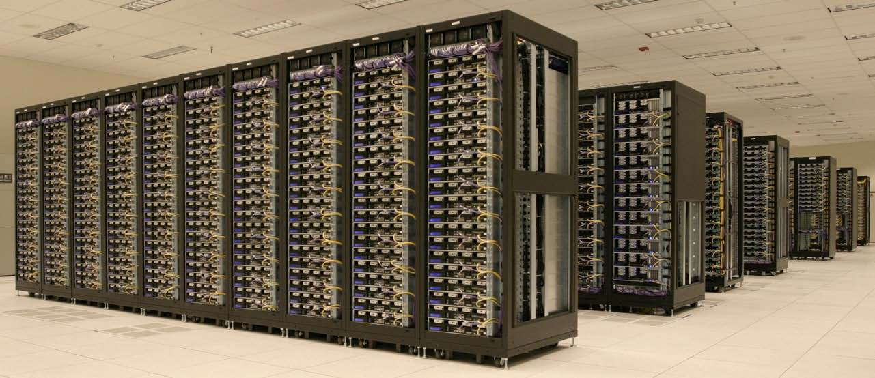
Hardware: Cluster Nodes
Workstations are usually commercial-off-the-shelf (COTS) computers:
Cost effective
No vendor lock-in
These machines have fairly common components (CPU, memory, disk).
They do not have any specialty components.
Notes:
Instructor Notes:
Instructor Notes are the same as Participant Notes.
Please present the Participant Notes.
Participant Notes:
Most popular common hardware vendors are:
Dell
Hewlett Packard (HP)
Cisco
Super Micro
These integrators build machines using common components (like CPUs from Intel).
As the cost of hardware keeps falling, the machines get cheaper.
This picture shows the Hadoop cluster at Yahoo circa 2007.
As you can see the Hadoop cluster consists of 100s of machines.
Each node is a server, stacked on a rack.

Slide 12
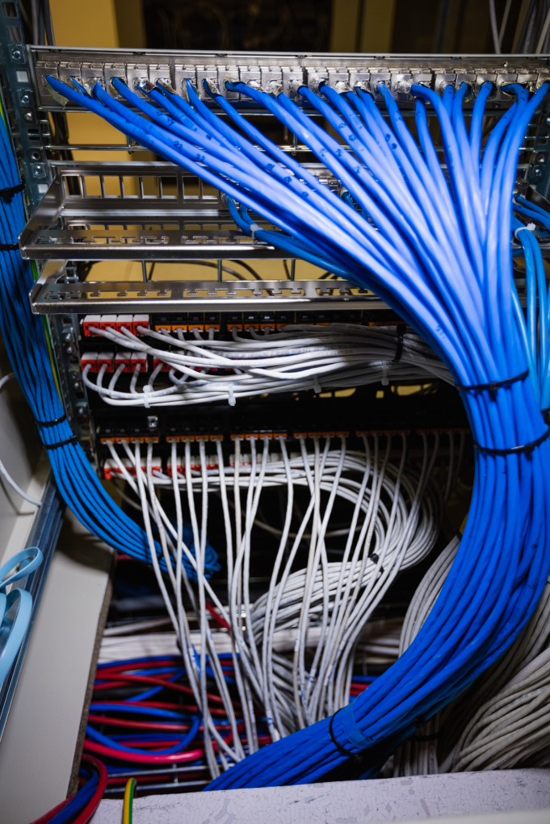
Networking Gear
Cluster machines need to have very good bandwidth
Especially for Big Data processing
Each node will have 1 Gigabit network hardware at minimum
Usually it is recommended to have two 1 Gigabit links 'bonded”
10 Gigabit hardware is recommended
Enormous bandwidth
Very low latency
Notes:
Instructor Notes:
Instructor Notes are the same as Participant Notes.
Please present the Participant Notes.
Participant Notes:
For networking, it is recommended to use 'bonded' connections.
For example, if we have two 1Gbps links bonded, in the normal operating mode we will have 2Gpbs (1 + 1) bandwidth.
If one fails, we will still have another one operating at 1Gbps.
Also, 10 Gbps network switches and gear are pretty affordable now.
And 10 Gbps networking provides much higher bandwidth.

Slide 13
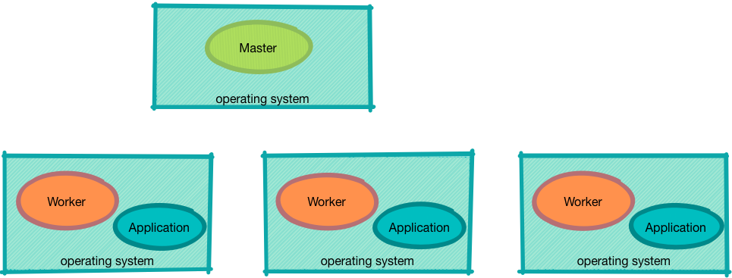
Software Components of Cluster
The most common software found in a cluster environment are:
Cluster Master/Coordinator
Cluster worker/agent
Operating system
Applications
Notes:
Instructor Notes:
We will be dissecting this diagram in the new few slides.
Participant Notes:
Software is the 'brain' in the modern cluster.
Remember, modern clusters are built on commodity hardware.
So the software has to be sophisticated, to deal with hardware failures.
There are many software components that make up the cluster.
We will be reviewing each one in more detail in the following slides.

Slide 14
Software Components of Cluster: Operating System
Operating System choices: Linux, Windows
OS must support:
Multiple users
Multiple applications
Process isolation
The latest networking protocols
It is a best practice to have the same version of OS throughout a cluster because it:
Simplifies management
Makes it easy to install upgrades, etc.
Notes:
Instructor Notes:
Instructor Notes are the same as Participant Notes.
Please present the Participant Notes.
Participant Notes:
In this diagram the Operating System (OS) is part of 'green boxes' which represent the compute machines.
OS is the underlying core of the software for the clusters.
OS must support modern hardware.
Examples would be, CPU hyper threads, etc.
Also, the OS must have a good ecosystem of software so we can build other applications on top of it.
Linux has become the de-facto OS for cluster computing because of the following:
It’s a very capable modern OS.
Very active community.
Built for servers (not loaded down with desktop specific features).
Open source - Essentially no licensing cost.
Very well field tested – it pretty much powers most of the Web.

Slide 15
Software Components of Cluster: Cluster Manager/Master
The Manager role plays an important part in a cluster.
It manages the 'entire' cluster.
Keeps an eye on the worker nodes, if they fail, the tasks are re-assigned to another worker node.
Monitors cluster health:
If some workers are exhibiting performance issues, workers can be 'blacklisted' or 'offlined‘.
'Offline' nodes won't be given any new tasks until the issues are resolved.
Notes:
Instructor Notes:
Review 'single point of failure' scenario with the class
Participant Notes:
In this diagram Master is represented as 'green oval' on the top machine.
In Master-Worker architecture, the Master is the brain of the cluster.
Master is in charge of keeping the cluster running smoothly.
The Master itself doesn't run the actual compute tasks, Workers run those.
Since the Master is very important in the cluster, it's failure can lead to the failure of the entire cluster.
More on this later.

Slide 16
Software Components of Cluster: Agent/Worker
Agent/Worker's role is to manage a SINGLE machine/node.
It runs applications locally.
Reports to master periodically using 'Heart Beat' signal.
Heart Beat:
Sent periodically, every few seconds.
Contains worker status (how busy, how many applications are running, etc.).
If a worker crashes, it's workload is automatically assigned to another worker.
Notes:
Instructor Notes:
Instructor Notes are the same as Participant Notes.
Please present the Participant Notes.
Participant Notes:
In this diagram, 'Worker' is represented as 'orange ovals' on machines at the bottom level.
In a cluster, there are usually many Workers running.
Each worker runs on a separate machine/node/host.
(While it is theoretically possible to run multiple workers per node, in practice this is not recommended. You just won't get much performance out of it)
Workers are in charge of the single machine they are running on.
They coordinate with the Master on running applications.

Slide 17
Popular Cluster Architectures
Notes:
Instructor Notes:
This section goes over some of the popular cluster design patterns
Participant Notes:

Slide 18
Cluster Architectures
Master Worker
A 'hierarchical' architecture with one or more masters and multiple workers.
Popular design choice, as it simplifies cluster design.
Examples: Hadoop, Spark, Kafka.
Peer to Peer (P2P)
A 'ring' architecture where no node is special.
Avoids 'single point of failure' scenario.
Example: Cassandra, Redis
Notes:
Instructor Notes:
Instructor Notes are the same as Participant Notes.
Please present the Participant Notes.
Participant Notes:
We are looking at current, modern architectures: Master based and Peer-to-Peer based.
In the next few slides, we will examine each design in detail.

Slide 19
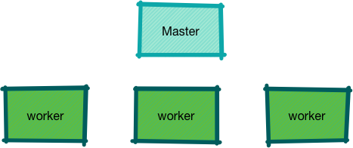
Cluster Architectures: Master-Worker
In this option, there is a single master that acts as a coordinator.
Multiple workers run the applications.
Worker failure is not critical – other workers can pick up the slack.
Master failure is critical – so we will have a backup master.
Examples: Hadoop, Spark
Notes:
Instructor Notes:
Instructor Notes are the same as Participant Notes.
Please present the Participant Notes.
Participant Notes:
Master-Worker design is arguably the most popular design.
It simplifies designing the cluster compared to peer-to-peer systems.
The Master and Worker have different responsibilities.
Workers run applications on their machines.
Master coordinates all the workers in the cluster.
It also keeps an eye on Workers; if a Worker fails, its tasks are re-assigned to another Worker.
However, we do have a design flaw.
The Master is a 'single point of failure' – when the Master fails, the entire cluster fails.
In the next slide, we will see how to fix this problem.

Slide 20
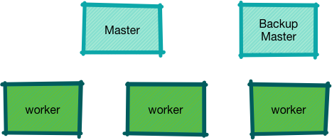
Master-Worker Design: Eliminating 'Single Point of Failure'
A single master system is susceptible for 'single point of failure':
When the master fails the entire cluster fails too.
The solution is to add a backup master.
When the active master fails, the backup will take over.
Notes:
Instructor Notes:
Instructor Notes are the same as Participant Notes.
Please present the Participant Notes.
Participant Notes:
Having a backup master eliminates the probability of 'single point of failure'.
It doesn't completely eliminate it.
The switching from active to backup can be done manually or automatically.
Modern cluster compute services, like Zookeeper, can do the switch automatically.
We will look at Zookeeper in another section.
Now if you are wondering 'what if backup master also fails?'.
We will look at a possible solution in the next module.

Slide 21
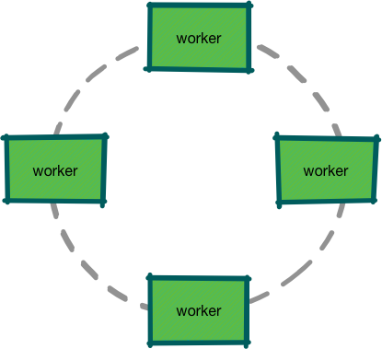
Cluster Architectures: Peer-to-Peer (P2P)
In P2P architecture there is no master node.
All nodes are equal and share responsibilities.
Usually depicted as a 'ring' instead of the hierarchical structure.
Not one single point of failure.
Examples: Cassandra
Notes:
Instructor Notes:
Instructor Notes are the same as Participant Notes.
Please present the Participant Notes.
Participant Notes:
In P2P all nodes are equal.
So it eliminates a 'single master failure' problem.
Workers may elect a 'controller' node to serve as coordinator.
This controller responsibility rotates periodically across nodes to avoid one node becoming a 'permanent master'.

Slide 22
CAP Theorem
Notes:
Instructor Notes:
This section goes over the CAP theorem.
Participant Notes:

Slide 23
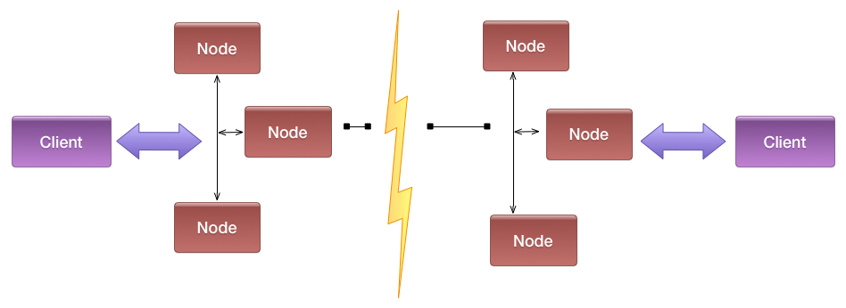
CAP Theorem
CAP theorem was proposed by Eric Brewer around 1999.
CAP stands for:
C for Consistency: The data is consistent across nodes/replicas.
A for Availability: The system is highly available.
P for Partitioning: System keeps working even when the system suffers a network disruption.
CAP theorem states we can have two out of these three properties at any time.
Notes:
Instructor Notes:
Instructor Notes are the same as Participant Notes.
Please present the Participant Notes.
Participant Notes:
CAP is frequently misunderstood as if one has to choose to abandon one of the three guarantees at all times. In fact, the choice is really between consistency and availability only when a network partition or failure happens; at all other times, no trade-off has to be made.
https://en.wikipedia.org/wiki/CAP_theorem
https://towardsdatascience.com/cap-theorem-and-distributed-database-management-systems-5c2be977950e

Slide 24
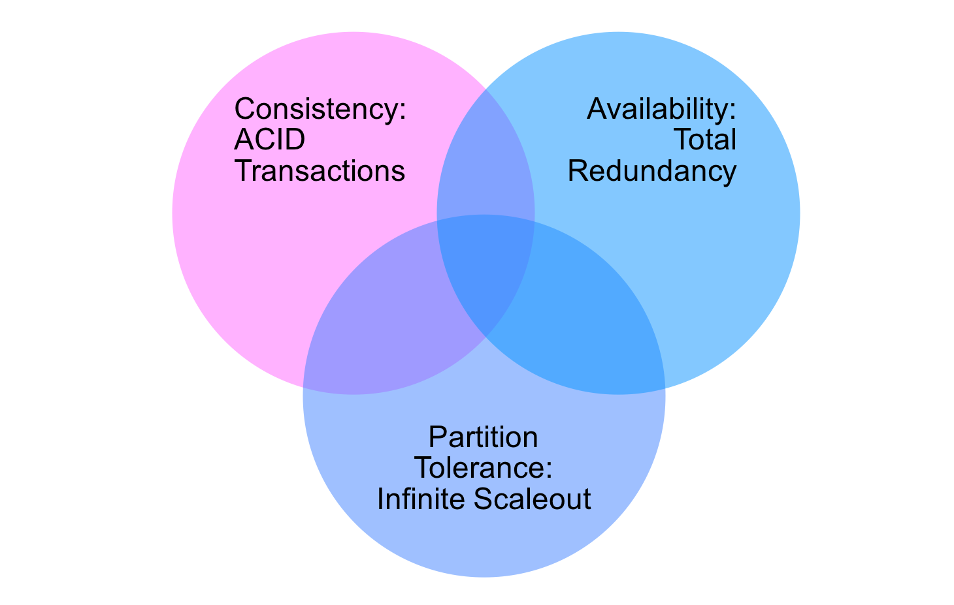
CAP Theorem
Notes:
Instructor Notes:
Instructor Notes are the same as Participant Notes.
Please present the Participant Notes.
Participant Notes:
As we see, there is nothing in the intersection of all three circles.
This is CAP theorem.

Slide 25
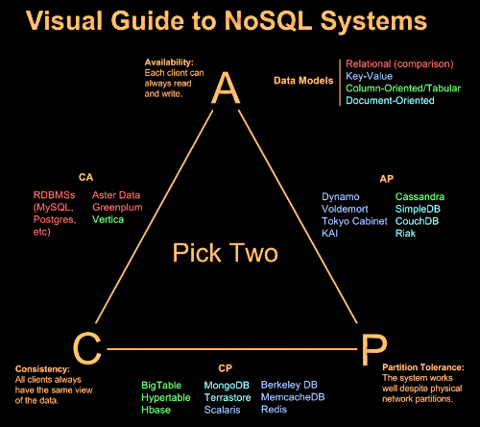
CAP Classification
Notes:
Instructor Notes:
Instructor Notes are the same as Participant Notes.
Please present the Participant Notes.
Participant Notes:
This is a nice diagram classifying lot of cluster systems in CAP triangle.
The text is color-coded for easy reference.
For example blue text denotes 'key value' data systems.
Image credit : http://digbigdata.com/know-thy-cap-theorem-for-nosql/

Slide 26
Labs
Notes:
Instructor Notes:
This section goes over some of the popular cluster design patterns
Participant Notes:

Slide 27

Cluster Compute Systems Review: A Group Exercise
Overview:
Time: 15 mins
In this exercise you will:
Discuss various cluster computing environments participants have used.
Delve into pros/cons of each system and how it can be improved.
Talking Points:
Has anyone used SETI@Home? What kind of computing is it? https://setiathome.berkeley.edu/
Notes:
Instructor Notes:
Facilitate discussion by encouraging students to do white boarding.
Participant Notes:

Slide 28
Discussion: TBD
Placeholder for second discussion question
Overview:
Time: 10 Minutes
In this exercise, you will: discuss the major concept of cluster computing.
Instructions:
This is a full class discussion.
Questions:
How would you define cluster computing?
What are the use cases for cluster computing?
What are the challenges of organizing clusters?
Notes:
Instructor Notes:
Purpose:.
Questions:
TBD
Instruction Time Estimate: TBD minutes.
Instructions: This is a full class discussion.
Answer:
Follow-up/Debrief:
Participant Notes:

Slide 29
Lab: TBD
Placeholder for the Lab
Overview:
Time: 30 Minutes
In this exercise, you will: Set up Docker.
Instructions:
This is a full class discussion.
302-08_Kubernetes_introduction_Part-1_Lab.docx
Notes:
Instructor Notes:
Purpose:.
Questions:
TBD
Instruction Time Estimate: TBD minutes.
Instructions: This is a full class discussion.
Answer:
Follow-up/Debrief:
Participant Notes:

Slide 32
Appendix
Notes:
Instructor Notes:
Participant Notes:

Slide 33
Recommended Reading
The Distributed Computing Paradigms: P2P, Grid, Cluster, Cloud, and Jungle

